Slide 1
Dr. Yifeng Zhu Electrical and Computer Engineering University of Maine
Embedded Systems with ARM Cortex-M Microcontrollers in Assembly Language and C
Chapter 11
Interrupt
Spring 2020

Slide 2
Interrupts
Motivations
Inform a program of some external events timely
Polling vs Interrupt
Implement multi-tasking with priority support
Merriam-Webster:
“to break the uniformity or continuity of”

Slide 3

Polling vs Interrupt
Polling:
You pick up the phone every three seconds to check whether you are getting a call.
Interrupt:
Do whatever you should do and pick up the phone when it rings.
Image from http://vecto.rs

Slide 4
Example: Push a button to turn on a LED
Check whether a button has been pressed?
Polling
Repeatedly read IDR and check whether bit 3 is set (i.e., busy wait)
OK if CPU has nothing else to do
Interrupt
When hardware detects a rising or fall edge, hardware generates a service request
CPU responses to the service request and starts to execute the corresponding service subroutine
Voltage on PA.3

Slide 5
Polling vs Interrupt
Interrupt-driven operations
Allows CPU to perform other tasks until external/internal devices require service
CPU automatically stops the current code and starts to execute an interrupt handler (or called interrupt service routine, ISR)
CPU
device
Busy
main()
interrupt
request
Ready
ISR()
time

Slide 6
Polling vs Interrupt
Interrupt-driven operations
Allows CPU to perform other tasks until external/internal devices require service
CPU automatically stops the current code and starts to execute an interrupt handler (or interrupt service routine)
Polling | Interrupt
Software periodically checks | CPU only takes actions only if an event occurs
Waste lot of CPU cycles | Does not waste much CPU cycle
Triggered by software | Triggered by hardware or software
Occurs periodically | Occurs at any time

Slide 7
How to support interrupt?
Edge Detector
ARM Cortex-M
Interrupt Controller
Interrupt Request
Execution
Core
Interrupt Request
Flash
Stop the current code
Service the interrupt request (i.e. turn on the LED)
Resume the previous code
ISR
ISR: Interrupt Service Handler
Microcontroller Chip

Slide 8
How to support interrupt?
Edge Detector
ARM Cortex-M
Interrupt Controller
Interrupt Request
Execution
Core
Interrupt Request
UART
Coordinates multiple interrupt sources
Enable and disable a specific interrupt
Which one service first (interrupt priority)
How to locate the corresponding ISR?
How to resume the code that has been suspended?
Microcontroller Chip

Slide 9
How to support interrupt?
Edge Detector
ARM Cortex-M
NVIC
Interrupt Request
Execution
Core
Interrupt Request
Nested Vectored Interrupt Controller
UART
Coordinates multiple interrupt sources
Enable and disable a specific interrupt
Which one service first (interrupt priority)
How to locate the corresponding ISR?
How to resume the code that has been suspended?
Microcontroller Chip

Slide 10
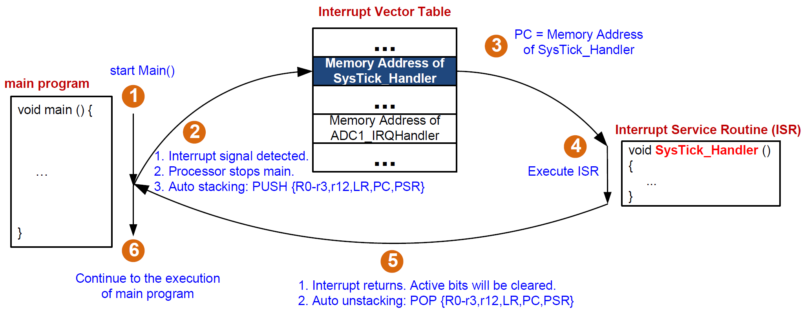
Interrupt

Slide 11
Interrupt Service Routine Vector Table
Start address for the exception hander for each exception type is fixed and pre-defined
Processor loads PC with this fixed, pre-defined address
Exception Vector Table starts at memory address 0
Program Counter pc = 0x00000004 initially
Address | Priority | Type of priority | Acronym | Description
0x0000_0000 | - | - | - | Stack Pointer
0x0000_0004 | -3 | fixed | Reset | Reset Vector
0x0000_0008 | -2 | fixed | NMI_Handler | Non maskable interrupt. The RCC Clock Security System (CSS) is linked to the NMI vector.
0x0000_000C | -1 | fixed | HardFault_Handler | All class of fault
0x0000_0010 | 0 | settable | MemManage_Handler | Memory management
0x0000_0014 | 1 | settable | BusFault_Handler | Pre-fetch fault, memory access fault
0x0000_0018 | 2 | settable | UsageFault_Handler | Undefined instruction or illegal state
0x0000_001C-0x0000_002B | - | - | - | Reserved
0x0000_002C | 3 | settable | SVC_Handler | System service call via SWI instruction
0x0000_0030 | 4 | settable | DebugMon_Handler | Debug Monitor
0x0000_0034 | - | - | - | Reserved
0x0000_0038 | 5 | settable | PendSV_Handler | Pendable request for system service
0x0000_003C | 6 | settable | SysTick_Handler | System tick timer
…

Slide 12
ISR Vector Table
For interrupt number n: (the interrupt shown in the xPSR)
CMSIS Interrupt Number = 16 + n

Slide 13
Automatic Stacking & Unstacking
Interrupt
Exit
Interrupt Handler
Interrupt
Signal
Unstacking
User Program
User Program
Stacking
Time
Thread Mode
Handler Mode
Thread Mode
Stacking: hardware automatically pushes eight register into the stack
(xPSR,PC,LR,r12,r3,r2,r1,r0)
Unstacking: hardware automatically pops these eight register off the stack

Slide 14
Automatic Stacking & Unstacking
Full descending stack
Old SP
SP + 0x20 | xxxxxxxx
SP + 0x1C | xPSP
SP + 0x18 | PC (r15)
SP + 0x14 | LR (r14)
SP + 0x10 | r12
SP + 0x0C | r3
SP + 0x08 | r2
SP + 0x04 | r1
SP | r0
New SP
Stacking
Unstacking
New SP
Old SP

Slide 15
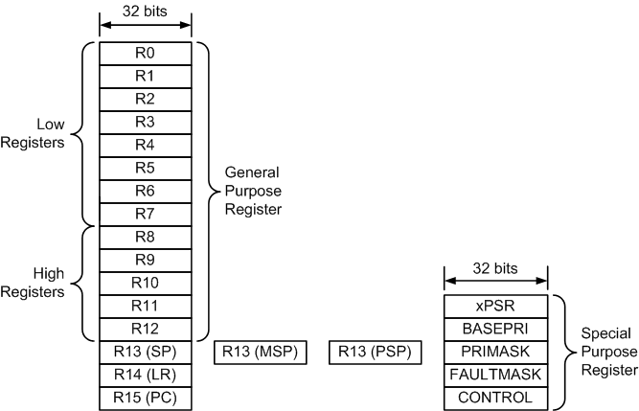
Stack Pointer: MSP vs PSP
For interrupts, which stack does auto stacking/unstacking use?
Depends on
processor mode: thread vs handler
setting in the control register
MSP: Main Stack Pointer (selected at reset)
PSP: Process Stack Pointer
In assembly, both MSP and PSP are called R13 or SP

Slide 16
Control Register
31 - 3 | 2 | 1 | 0
Reserved | FPCA | SPSEL | nPRIV
0: FP inactive (default)
1: FP active
By default, MSP is used.
0: SP = MSP (default)
1: SP = PSP if in Thread Mode
0: Thread mode has privileged access (default)
1: Thread mode has unprivileged access
; Access special registers
MRS r0, CONTROL ; Read CONTROL into R0
ORRS r0, R0, #0x2 ; Set SPSEL to select PSP
MSR CONTROL, r0 ; Write R0 into CONTROL
ISB ; Instruction Synchronization Barrier
Notes:
Software can use the MRS instruction to read the register, and the MSR instruction to write to the register.
MRS: Move to Register from Special Register
MSR: Move to Special Register from ARM Register
An ISB instruction flushes the pipeline in the processor, so that all instructions that come after the ISB instruction in program order are fetched from cache or memory only after the ISB instruction has completed. Using an ISB ensures that the effects of context altering operations executed before the ISB are visible to the instructions fetched after the ISB instruction.

Slide 17
Control Register
31 - 3 | 2 | 1 | 0
Reserved | FPCA | SPSEL | nPRIV
0: FP inactive (default)
1: FP active
By default, MSP is used.
0: SP = MSP (default)
1: SP = PSP if in Thread Mode
0: Thread mode has privileged access (default)
1: Thread mode has unprivileged access
 | SP | Privileged
Handler Mode | SP = MSP and SPSEL = 0 | Privileged
Thread Mode | Depending on SPSEL | Depending on nPRIV
For simple applications, MSP is used.
Notes:
Software can use the MRS instruction to read the register, and the MSR instruction to write to the register.

Slide 18
Automatic Stacking & Unstacking
Old SP
SP + 0x20 | xxxxxxxx
SP + 0x1C | xPSP
SP + 0x18 | PC (r15)
SP + 0x14 | LR (r14)
SP + 0x10 | r12
SP + 0x0C | r3
SP + 0x08 | r2
SP + 0x04 | r1
SP + 0x00 | r0
Stacking: The processor automatically pushes these eight registers into the currently selected stack before an interrupt handler starts
Unstacking: The processor automatically pops these eight register out of the currently selected stack when an interrupt hander exits.
Full Descending Stack
New SP

Slide 19
MSP vs PSP
Handler Mode
How does the processor know which stack was selected?
SPSEL = 0
MSP is used.
Use LR to indicate
Auto stacking by using currently selected selected stack
Start to execute interrupt handler
Exit interrupt handler
Auto unstacking by using currently selected stack
Thread Mode
Start of main()
SPSEL = 0
MSP is used.
SPSEL = 1
PSP is used.

Slide 20
Recall: Link Register for calling functions
void foo(void) ;
int main(void{
● ● ●
foo();
● ● ●
}
void foo (void) {
● ● ●
● ● ●
return;
}
Transfer control to callee
Resume suspended caller
Compiler
LR = PC + 4
PC = foo
● ● ●
BL foo
● ● ●
PC
foo PROC
● ● ●
● ● ●
BX LR
ENDP
PC + 4

Slide 21
Link Register (LR)
When software calls a subroutine, LR holds the returning address.
Does does LR hold when serving an interrupt?

Slide 22
Which stack to use when an interrupt returns?
Link Register (LR) now has two usages:
LR = address of the instruction immediately after BL
LR indicates whether MSP or PSP is used to restore register from when exiting an interrupt
FPU was not used before interrupt (FPCA bit in Control register = 0):
Return Mode | Link Register (LR) | Return Stack
Handler | 0xFFFFFFF1 | SP = MSP
Thread | 0xFFFFFFF9 | SP = MSP
 | 0xFFFFFFFD | SP = PSP
FPU was used before interrupt (FPCA bit in Control register = 1):
Return Mode | Link Register (LR) | Return Stack
Handler | 0xFFFFFFE1 | SP = MSP
Thread | 0xFFFFFFE9 | SP = MSP
 | 0xFFFFFFED | SP = PSP

Slide 23
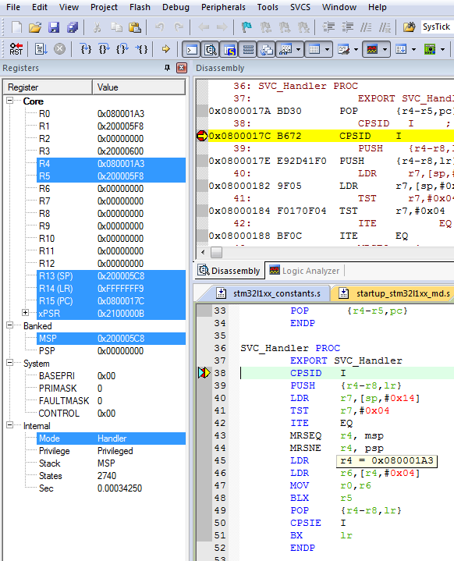
Register values in a interrupt service routine
LR = 0xFFFFFFF9
SP = MSP
ISR always in hander mode.

Slide 24
Stacking & Unstacking
Assume SPSEL = 0 and no FP is used ⟹ User program uses MSP.
xPSR,PC,LR,R12,R3,R2,R1,R0
Interrupt
Exit
Interrupt Handler
Interrupt
Signal
Unstacking
from MSP
User Program
User Program
Stacking
onto MSP
Time
Thread Mode
Handler Mode
Thread Mode
MSP
MSP
MSP
LR = Some Value
LR = 0xFFFFFFF9
LR is recovered to old value

Slide 25
Stacking & Unstacking
Assume SPSEL = 1 and no FP is used ⟹ User program uses PSP.
If the interrupt handler calls push or pop, the MSP is used.
Interrupt
Exit
Interrupt Handler
Interrupt
Signal
Unstacking
from PSP
User Program
User Program
Stacking
onto PSP
Time
Thread Mode
Handler Mode
Thread Mode
PSP
MSP
PSP
LR = Some Value
LR = 0xFFFFFFFD
LR is recovered to old value

Slide 26
Which stack was used for stacking?
Suppose in an interrupt handler, we want to push registers onto the same stack that was selected for automatic stacking
After an interrupt:
If LR = 0xFFFFFFF9, then MSP was used for auto stacking
If LR = 0xFFFFFFFD, then PSP was used for auto stacking
9 = 1001
D = 1101
SysTick_Handler
EXPORT SysTick_Handler
TST LR, #4 ; check bit 2 of LR
MRSEQ r0, msp ; if 0, MSP was used
MRSNE r0, psp ; if 1, PSP was used
STMFD r0!, {r7-r9} ; Push onto a Full Descending Stack
; Note: we cannot use PUSH {r7-r9} because PUSH uses MSP
; in a interrupt service routine

Slide 27
Interrupt: Stacking & Unstacking
__main PROC
…
MOV r3,#0
…
ENDP
SysTick_Handler PROC
EXPORT SysTick_Handler
ADD r3, #1
ADD r4, #1
BX lr
ENDP
R0
0
xxxxxxxx
0x20000200
addr = 0x08000044
R1
1
0x200001FC
R2
2
0x200001F8
R3
3
0x200001F4
addr = 0x0800001C
R4
4
0x200001F0
R12
12
0x200001EC
R13(SP)
MSP
0x200001E8
R14(LR)
0x08001000
0x200001E4
R15(PC)
0x08000044
0x200001E0
0x200001DC
xPSR
0x21000000
0x200001D8
MSP
0x20000200
0x200001D4
0x200001D0
PSP
0x00000000
0x200001CF
Memory

Slide 28
Interrupt: Stacking & Unstacking
Suppose SysTick interrupt occurs when PC = 0x08000044
__main PROC
…
MOV r3,#0
…
ENDP
SysTick_Handler PROC
EXPORT SysTick_Handler
ADD r3, #1
ADD r4, #1
BX lr
ENDP
R0
0
xxxxxxxx
0x20000200
addr = 0x08000044
R1
1
0x200001FC
R2
2
0x200001F8
R3
3
0x200001F4
addr = 0x0800001C
R4
4
0x200001F0
R12
12
0x200001EC
R13(SP)
MSP
0x200001E8
R14(LR)
0x08001000
0x200001E4
R15(PC)
0x08000044
0x200001E0
0x200001DC
xPSR
0x21000000
0x200001D8
MSP
0x20000200
0x200001D4
0x200001D0
PSP
0x00000000
0x200001CF
Memory

Slide 29
Interrupt: Stacking & Unstacking
STACKING
__main PROC
…
MOV r3,#0
…
ENDP
SysTick_Handler PROC
EXPORT SysTick_Handler
ADD r3, #1
ADD r4, #1
BX lr
ENDP
R0
0
xxxxxxxx
0x20000200
addr = 0x08000044
R1
1
xPSR
0x21000000
0x200001FC
R2
2
PC
0x08000044
0x200001F8
R3
3
LR
0x08001000
0x200001F4
addr = 0x0800001C
R4
4
R12
12
0x200001F0
R12
12
R3
3
0x200001EC
R13(SP)
MSP
R2
2
0x200001E8
R14(LR)
0xFFFFFFF9
R1
1
0x200001E4
R15(PC)
0x0800001C
R0
0
0x200001E0
0x200001DC
xPSR
0x21000000
0x200001D8
MSP
0x200001E0
0x200001D4
0x200001D0
PSP
0x00000000
0x200001CF
Memory

Slide 30
Interrupt: Stacking & Unstacking
STACKING
__main PROC
…
MOV r3,#0
…
ENDP
SysTick_Handler PROC
EXPORT SysTick_Handler
ADD r3, #1
ADD r4, #1
BX lr
ENDP
R0
0
xxxxxxxx
0x20000200
addr = 0x08000044
R1
1
xPSR
0x21000000
0x200001FC
R2
2
PC
0x08000044
0x200001F8
R3
3
LR
0x08001000
0x200001F4
addr = 0x0800001C
R4
4
R12
12
0x200001F0
R12
12
R3
3
0x200001EC
R13(SP)
MSP
R2
2
0x200001E8
R14(LR)
0xFFFFFFF9
R1
1
0x200001E4
R15(PC)
0x0800001C
R0
0
0x200001E0
0x200001DC
xPSR
0x21000000
0x200001D8
MSP
0x200001E0
0x200001D4
LR = 0xFFFFFFF9 to indicate MSP is used.
0x200001D0
PSP
0x00000000
0x200001CF
Memory

Slide 31
Interrupt: Stacking & Unstacking
__main PROC
…
MOV r3,#0
…
ENDP
SysTick_Handler PROC
EXPORT SysTick_Handler
ADD r3, #1
ADD r4, #1
BX lr
ENDP
R0
0
xxxxxxxx
0x20000200
addr = 0x08000044
R1
1
xPSR
0x21000000
0x200001FC
R2
2
PC
0x08000044
0x200001F8
R3
4
LR
0x08001000
0x200001F4
addr = 0x0800001C
R4
4
R12
12
0x200001F0
R12
12
R3
3
0x200001EC
R13(SP)
MSP
R2
2
0x200001E8
R14(LR)
0xFFFFFFF9
R1
1
0x200001E4
R15(PC)
0x0800001C
R0
0
0x200001E0
0x200001DC
xPSR
0x21000000
0x200001D8
MSP
0x200001E0
0x200001D4
0x200001D0
PSP
0x00000000
0x200001CF
Memory

Slide 32
Interrupt: Stacking & Unstacking
__main PROC
…
MOV r3,#0
…
ENDP
SysTick_Handler PROC
EXPORT SysTick_Handler
ADD r3, #1
ADD r4, #1
BX lr
ENDP
R0
0
xxxxxxxx
0x20000200
addr = 0x08000044
R1
1
xPSR
0x21000000
0x200001FC
R2
2
PC
0x08000044
0x200001F8
R3
4
LR
0x08001000
0x200001F4
addr = 0x0800001C
R4
5
R12
12
0x200001F0
R12
12
R3
3
0x200001EC
R13(SP)
MSP
R2
2
0x200001E8
R14(LR)
0xFFFFFFF9
R1
1
0x200001E4
R15(PC)
0x08000020
R0
0
0x200001E0
0x200001DC
xPSR
0x21000000
0x200001D8
MSP
0x200001E0
0x200001D4
0x200001D0
PSP
0x00000000
0x200001CF
Memory

Slide 33
Interrupt: Stacking & Unstacking
__main PROC
…
MOV r3,#0
…
ENDP
SysTick_Handler PROC
EXPORT SysTick_Handler
ADD r3, #1
ADD r4, #1
BX lr
ENDP
R0
0
xxxxxxxx
0x20000200
addr = 0x08000044
R1
1
xPSR
0x21000000
0x200001FC
R2
2
PC
0x08000044
0x200001F8
R3
4
LR
0x08001000
0x200001F4
addr = 0x0800001C
R4
5
R12
12
0x200001F0
R12
12
R3
3
0x200001EC
R13(SP)
MSP
R2
2
0x200001E8
R14(LR)
0xFFFFFFF9
R1
1
0x200001E4
R15(PC)
0x08000024
R0
0
0x200001E0
0x200001DC
xPSR
0x21000000
0x200001D8
MSP
0x200001E0
0x200001D4
LR = 0xFFFFFFF9 to indicate MSP is used.
0x200001D0
PSP
0x00000000
0x200001CF
Memory

Slide 34
Interrupt: Stacking & Unstacking
UNSTACKING
__main PROC
…
MOV r3,#0
…
ENDP
SysTick_Handler PROC
EXPORT SysTick_Handler
ADD r3, #1
ADD r4, #1
BX lr
ENDP
R0
0
xxxxxxxx
0x20000200
addr = 0x08000044
R1
1
xPSR
0x21000000
0x200001FC
R2
2
PC
0x08000044
0x200001F8
R3
4
LR
0x08001000
0x200001F4
addr = 0x0800001C
R4
5
R12
12
0x200001F0
R12
12
R3
3
0x200001EC
R13(SP)
MSP
R2
2
0x200001E8
R14(LR)
0xFFFFFFF9
R1
1
0x200001E4
R15(PC)
0x08000024
R0
0
0x200001E0
0x200001DC
xPSR
0x21000000
0x200001D8
MSP
0x200001E0
0x200001D4
LR = 0xFFFFFFF9 to indicate MSP is used.
0x200001D0
PSP
0x00000000
0x200001CF
Memory

Slide 35
Interrupt: Stacking & Unstacking
UNSTACKING
__main PROC
…
MOV r3,#0
…
ENDP
SysTick_Handler PROC
EXPORT SysTick_Handler
ADD r3, #1
ADD r4, #1
BX lr
ENDP
R0
0
xxxxxxxx
0x20000200
addr = 0x08000044
R1
1
0x200001FC
R2
2
0x200001F8
R3
3
0x200001F4
addr = 0x0800001C
R4
5
0x200001F0
R12
12
0x200001EC
R13(SP)
MSP
0x200001E8
R14(LR)
0x08001000
0x200001E4
R15(PC)
0x08000044
0x200001E0
0x200001DC
xPSR
0x21000000
0x200001D8
MSP
0x20000200
0x200001D4
Note the new value of R3 is lost!!!
0x200001D0
PSP
0x00000000
0x200001CF
Memory

Slide 36
Interrupt: Stacking & Unstacking
__main PROC
…
MOV r3,#0
…
ENDP
SysTick_Handler PROC
EXPORT SysTick_Handler
ADD r3, #1
ADD r4, #1
BX lr
ENDP
R0
0
xxxxxxxx
0x20000200
addr = 0x08000044
R1
1
0x200001FC
R2
2
0x200001F8
R3
3
0x200001F4
addr = 0x0800001C
R4
5
0x200001F0
R12
12
0x200001EC
R13(SP)
MSP
0x200001E8
R14(LR)
0x08001000
0x200001E4
R15(PC)
0x08000044
0x200001E0
0x200001DC
xPSR
0x21000000
0x200001D8
MSP
0x20000200
0x200001D4
The Main program resumes!!!
0x200001D0
PSP
0x00000000
0x200001CF
Memory

Slide 37
Interrupt: Stacking & Unstacking
__main PROC
…
MOV r3,#0
…
ENDP
SysTick_Handler PROC
EXPORT SysTick_Handler
ADD r4, #1
BL sine
BX lr
ENDP
R0
0
xxxxxxxx
0x20000200
addr = 0x08000044
R1
1
0x200001FC
R2
2
0x200001F8
R3
3
0x200001F4
addr = 0x0800001C
R4
4
0x200001F0
R12
12
0x200001EC
R13(SP)
MSP
0x200001E8
0x0800001C
R14(LR)
0x08001000
0x200001E4
0x08000020
R15(PC)
0x08000044
0x200001E0
0x08000024
0x200001DC
xPSR
0x21000000
0x200001D8
MSP
0x20000200
0x200001D4
0x200001D0
PSP
0x00000000
0x200001CF
Memory

Slide 38
Interrupt: Stacking & Unstacking
STACKING
__main PROC
…
MOV r3,#0
…
ENDP
SysTick_Handler PROC
EXPORT SysTick_Handler
ADD r4, #1
BL sine
BX lr
ENDP
R0
0
xxxxxxxx
0x20000200
addr = 0x08000044
R1
1
xPSR
0x21000000
0x200001FC
R2
2
PC
0x08000044
0x200001F8
R3
3
SP
0x20000200
0x200001F4
addr = 0x0800001C
R4
4
LR
0x08001000
0x200001F0
R12
12
R3
3
0x200001EC
R13(SP)
MSP
R2
2
0x200001E8
0x0800001C
R14(LR)
0xFFFFFFF9
R1
1
0x200001E4
0x08000020
R15(PC)
0x0800001C
R0
0
0x200001E0
0x08000024
0x200001DC
xPSR
0x21000000
0x200001D8
MSP
0x200001E0
0x200001D4
LR = 0xFFFFFFF9 to indicate MSP is used.
0x200001D0
PSP
0x00000000
0x200001CF
Memory

Slide 39
Interrupt: Stacking & Unstacking
__main PROC
…
MOV r3,#0
…
ENDP
SysTick_Handler PROC
EXPORT SysTick_Handler
ADD r4, #1
BL sine
BX lr
ENDP
R0
0
xxxxxxxx
0x20000200
addr = 0x08000044
R1
1
xPSR
0x21000000
0x200001FC
R2
2
PC
0x08000044
0x200001F8
R3
3
SP
0x20000200
0x200001F4
addr = 0x0800001C
R4
5
LR
0x08001000
0x200001F0
R12
12
R3
3
0x200001EC
R13(SP)
MSP
R2
2
0x200001E8
0x0800001C
R14(LR)
0xFFFFFFF9
R1
1
0x200001E4
0x08000020
R15(PC)
0x08000020
R0
0
0x200001E0
0x08000024
0x200001DC
xPSR
0x21000000
0x200001D8
MSP
0x200001E0
0x200001D4
LR = 0xFFFFFFF9 to indicate MSP is used.
0x200001D0
PSP
0x00000000
0x200001CF
Memory

Slide 40
Interrupt: Stacking & Unstacking
__main PROC
…
MOV r3,#0
…
ENDP
SysTick_Handler PROC
EXPORT SysTick_Handler
ADD r4, #1
BL sine
BX lr
ENDP
R0
0
xxxxxxxx
0x20000200
addr = 0x08000044
R1
1
xPSR
0x21000000
0x200001FC
R2
2
PC
0x08000044
0x200001F8
R3
3
SP
0x20000200
0x200001F4
addr = 0x0800001C
R4
4
LR
0x08001000
0x200001F0
R12
12
R3
3
0x200001EC
R13(SP)
MSP
R2
2
0x200001E8
0x0800001C
R14(LR)
0x08000024
R1
1
0x200001E4
0x08000020
R15(PC)
0x080000F0
R0
0
0x200001E0
0x08000024
0x200001DC
xPSR
0x21000000
0x200001D8
MSP
0x200001E0
0x200001D4
BL sine
Updates LR register
0x200001D0
PSP
0x00000000
0x200001CF
Memory
Assume sine() is located at 0x08000024.

Slide 41
Interrupt: Stacking & Unstacking
__main PROC
…
MOV r3,#0
…
ENDP
SysTick_Handler PROC
EXPORT SysTick_Handler
ADD r4, #1
BL sine
BX lr
ENDP
R0
0
xxxxxxxx
0x20000200
addr = 0x08000044
R1
1
xPSR
0x21000000
0x200001FC
R2
2
PC
0x00000002
0x200001F8
R3
3
SP
0x20000200
0x200001F4
addr = 0x0800001C
R4
4
LR
0x08001000
0x200001F0
R12
12
R3
3
0x200001EC
R13(SP)
MSP
R2
2
0x200001E8
0x0800001C
R14(LR)
0x08000024
R1
1
0x200001E4
0x08000020
R15(PC)
0x080000F0
R0
0
0x200001E0
0x08000024
0x200001DC
xPSR
0x21000000
0x200001D8
MSP
0x200001E0
0x200001D4
BL sine
Updates LR register
0x200001D0
PSP
0x00000000
0x200001CF
Memory

Slide 42
Interrupt: Stacking & Unstacking
UNSTACKING won’t occur!
__main PROC
…
MOV r3,#0
…
ENDP
SysTick_Handler PROC
EXPORT SysTick_Handler
ADD r4, #1
BL sine
BX lr
ENDP
R0
0
xxxxxxxx
0x20000200
addr = 0x08000044
R1
1
xPSR
0x21000000
0x200001FC
R2
2
PC
0x00000002
0x200001F8
R3
3
SP
0x20000200
0x200001F4
addr = 0x0800001C
R4
4
LR
0x08001000
0x200001F0
R12
12
R3
3
0x200001EC
R13(SP)
MSP
R2
2
0x200001E8
0x0800001C
R14(LR)
0x08000024
R1
1
0x200001E4
0x08000020
R15(PC)
0x080000F0
R0
0
0x200001E0
0x08000024
0x200001DC
xPSR
0x21000000
0x200001D8
MSP
0x200001E0
0x200001D4
BL sine
Updates LR register
0x200001D0
PSP
0x00000000
0x200001CF
Memory

Slide 43
Interrupt: Stacking & Unstacking
__main PROC
…
MOV r3,#0
…
ENDP
SysTick_Handler PROC
EXPORT SysTick_Handler
PUSH {lr}
ADD r4, #1
BL sine
POP {lr}
BX lr
ENDP
R0
0
xxxxxxxx
0x20000200
addr = 0x08000044
R1
1
xPSR
0x21000000
0x200001FC
R2
2
PC
0x00000002
0x200001F8
R3
3
SP
0x20000200
0x200001F4
addr = 0x0800001C
R4
4
LR
0x08001000
0x200001F0
R12
12
R3
3
0x200001EC
R13(SP)
MSP
R2
2
0x200001E8
R14(LR)
0x08000024
R1
1
0x200001E4
R15(PC)
0x080000F0
R0
0
0x200001E0
LR
0xFFFFFFF9
0x200001DC
xPSR
0x21000000
0x200001D8
MSP
0x200001E0
0x200001D4
0x200001D0
PSP
0x00000000
0x200001CF
Fix the bug! Method 1
Memory

Slide 44
Interrupt: Stacking & Unstacking
__main PROC
…
MOV r3,#0
…
ENDP
SysTick_Handler PROC
EXPORT SysTick_Handler
PUSH {lr}
ADD r4, #1
BL sine
POP {PC}
ENDP
R0
0
xxxxxxxx
0x20000200
addr = 0x08000044
R1
1
xPSR
0x21000000
0x200001FC
R2
2
PC
0x00000002
0x200001F8
R3
3
SP
0x20000200
0x200001F4
addr = 0x0800001C
R4
4
LR
0x08001000
0x200001F0
R12
12
R3
3
0x200001EC
R13(SP)
MSP
R2
2
0x200001E8
R14(LR)
0x08000024
R1
1
0x200001E4
R15(PC)
0x080000F0
R0
0
0x200001E0
LR
0xFFFFFFF9
0x200001DC
xPSR
0x21000000
0x200001D8
MSP
0x200001E0
0x200001D4
0x200001D0
PSP
0x00000000
0x200001CF
Fix the bug! Method 2
Memory

Slide 45
Interrupt: Stacking & Unstacking
__main PROC
…
MOV r3,#0
…
ENDP
SysTick_Handler PROC
EXPORT SysTick_Handler
ADD r4, #1
BL sine
LDR lr,=0xFFFFFFF9
BX lr
ENDP
R0
0
xxxxxxxx
0x20000200
addr = 0x08000044
R1
1
xPSR
0x21000000
0x200001FC
R2
2
PC
0x00000002
0x200001F8
R3
3
SP
0x20000200
0x200001F4
addr = 0x0800001C
R4
4
LR
0x08001000
0x200001F0
R12
12
R3
3
0x200001EC
R13(SP)
MSP
R2
2
0x200001E8
R14(LR)
0x08000024
R1
1
0x200001E4
R15(PC)
0x080000F0
R0
0
0x200001E0
0x200001DC
xPSR
0x21000000
0x200001D8
MSP
0x200001E0
0x200001D4
0x200001D0
PSP
0x00000000
0x200001CF
Fix the bug! Method 3 (not recommended)
Memory

Slide 46
Enable an Interrupt
Peripheral
Interrupt Request
ARM Cortex-M
NVIC
Interrupt Request
Execution
Core
Two steps:
Program the peripheral control register to allow it to generate interrupts
Program NVIC to allow it to accept interrupts
Nested Vectored Interrupt Controller

Slide 47
Enable an Interrupt
Peripheral
Interrupt Request
ARM Cortex-M
NVIC
Interrupt Request
Execution
Core
Two steps:
Program the peripheral control register to allow it to generate interrupts
Program NVIC to allow it to accept interrupts
Nested Vectored Interrupt Controller
How?

Slide 48
Interrupt Number in PSR
Application PSR (APSR), Interrupt PSR (IPSR), Execution PSR (EPSR)
31
30
29
28
27
26
25
24
23
22
21
20
19
18
17
16
15
14
13
12
11
10
9
8
7
6
5
4
3
2
1
0
APSR
N
Z
C
V
Q
Reserved
GE
Reserved
IPSR
Reserved
ISR number
EPSR
ICI/IT
T
Reserved
ICI/IT
Combine them together into one register (PSR)
PSR
N
Z
C
V
Q
ICI/IT
T
Reserved
GE
Reserved
ICI/IT
ISR number
8-bit interrupt number in PSR
Range: 0 - 255

Slide 49
Interrupt Number in CMSIS Library
Interrupt number defined in ARM software library
First 16 are system exceptions
CMSIS defines their interrupt numbers as negative
Defined by ARM core
The rest 240 are peripheral interrupts
Peripheral interrupt number starts with 0.
Defined by chip manufacturers.
System
Exceptions
Peripheral
Interrupts
interrupt
number
-16
-1
0
239
CMSIS Interrupt Number
Notes:
{{Pause=2}} A Cortex M microcontroller supports up to 256 interrupts. Each interrupt, except the interrupt reset, has an interrupt number.
The first 16 interrupts are system interrupts, also called system exceptions. Exceptions are the interrupts that come from the core. C M S I S defines all system exceptions by using negative values. C M S I S stands for Cortex Microcontroller Software Interface Standard.
The rest 240 interrupts are peripheral interrupts, also called non-system exceptions. The peripheral interrupt number starts with 0.
This number scheme allows software to easily distinguish system exceptions and peripheral interrupts.
Peripheral interrupts are defined by chip manufacturers. The total number of peripheral interrupts supported varies among chips.

Slide 50
Interrupt Number in CMIS Library
/****** Cortex-M4 System Exceptions ********************************************************/
NonMaskableInt_IRQn = -14, /* 2 Cortex-M4 Non Maskable Interrupt */
HardFault_IRQn = -13, /* 3 Cortex-M4 Hard Fault Interrupt */
MemoryManagement_IRQn = -12, /* 4 Cortex-M4 Memory Management Interrupt */
BusFault_IRQn = -11, /* 5 Cortex-M4 Bus Fault Interrupt */
UsageFault_IRQn = -10, /* 6 Cortex-M4 Usage Fault Interrupt */
SVCall_IRQn = -5, /* 11 Cortex-M4 SV Call Interrupt */
DebugMonitor_IRQn = -4, /* 12 Cortex-M4 Debug Monitor Interrupt */
PendSV_IRQn = -2, /* 14 Cortex-M4 Pend SV Interrupt */
SysTick_IRQn = -1, /* 15 Cortex-M4 System Tick Interrupt */
/****** Peripheral Interrupt Numbers *******************************************************/
WWDG_IRQn = 0, /* Window WatchDog Interrupt */
PVD_PVM_IRQn = 1, /* PVD/PVM1,2,3,4 through EXTI Line detection Interrupts */
TAMP_STAMP_IRQn = 2, /* Tamper and TimeStamp interrupts through the EXTI line */
RTC_WKUP_IRQn = 3, /* RTC Wakeup interrupt through the EXTI line */
FLASH_IRQn = 4, /* FLASH global Interrupt */
RCC_IRQn = 5, /* RCC global Interrupt */
EXTI0_IRQn = 6, /* EXTI Line0 Interrupt */
...
System
Exceptions
Defined by ARM
Peripheral Interrupts
Defined by chip vendor
stm32l476xx.h
Notes:
{{Pause=2}}For a given microprocessor, the definition of the interrupt numbers is usually given in its device header file. This is the interrupt number definition for STM 32 L4 Cortex-M4 microprocessors. It includes negative values for system exceptions, and non-negative values for peripheral interrupts.

Slide 51
Interrupt Number in CMSIS vs in PSR
Interrupt number in Program Status Register (PSR)
Interrupt Number in PSR = 16 + Interrupt Number for CMSIS
Notes:
{{Pause=2}}Several C M S I S functions use the interrupt number as an input parameters, such as the function of N V I C disable interrupt, and N V I C enable interrupt. N V I C stands for Nested Vector Interrupt Controller.
On the other hand, when an interrupt is serviced, the current interrupt or exception number is recorded in the program status register (PSR). However, the definition of interrupt numbers in PSR is different from the definition of interrupt number in C M S I S functions.
Specifically, interrupt number of PSR equals 16 plus the interrupt number for C M S I S.
In this video, when we say interrupt number, we mean the interrupt number defined for C M S I S.

Slide 52
Interrupt Number
Interrupt number defined in ARM software library
System
Exceptions
Peripheral
Interrupts
interrupt
number
-16
-1
0
239
CMSIS Interrupt Number
Interrupt number for CMSIS functions
NVIC_DisableIRQ (IRQn); // Disable interrupt
NVIC_EnableIRQ (IRQn); // Enable interrupt NVIC_ClearingPending (IRQn); // clear pending status NVIC_SetPriority (IRQn, priority); // set priority level
Notes:
{{Pause=2}} A Cortex M microcontroller supports up to 256 interrupts. Each interrupt, except the interrupt reset, has an interrupt number.
The first 16 interrupts are system interrupts, also called system exceptions. Exceptions are the interrupts that come from the core. C M S I S defines all system exceptions by using negative values. C M S I S stands for Cortex Microcontroller Software Interface Standard.
The rest 240 interrupts are peripheral interrupts, also called non-system exceptions. The peripheral interrupt number starts with 0.
This number scheme allows software to easily distinguish system exceptions and peripheral interrupts.
Peripheral interrupts are defined by chip manufacturers. The total number of peripheral interrupts supported varies among chips.

Slide 53
Enable an Interrupt
Enable a system exception
Some are always enabled (cannot be disabled)
No centralized registers for enabling/disabling
Each are control by its corresponding components, such as SysTick module
Enable a peripheral interrupt
Centralized register arrays for enabling/disabling
ISER registers for enabling
ICER registers for disabling
Notes:
{{Pause=2}} Enabling a system exception is different from enabling a peripheral interrupt. There is no centralized enabling/disabling registers for system exceptions. Some system exceptions, such as reset and hard fault, cannot be disabled. They are always enabled. The other system exceptions can be enabled or disabled by their corresponding module, such as system timer.
On the other hand, the enabling and disabling all peripheral interrupts are implemented by modifying two sets of registers: ISER registers and ICER registers. Specifically, ISER registers are used to enable peripheral interrupts. ICER registers are used to disable peripheral interrupts

Slide 54
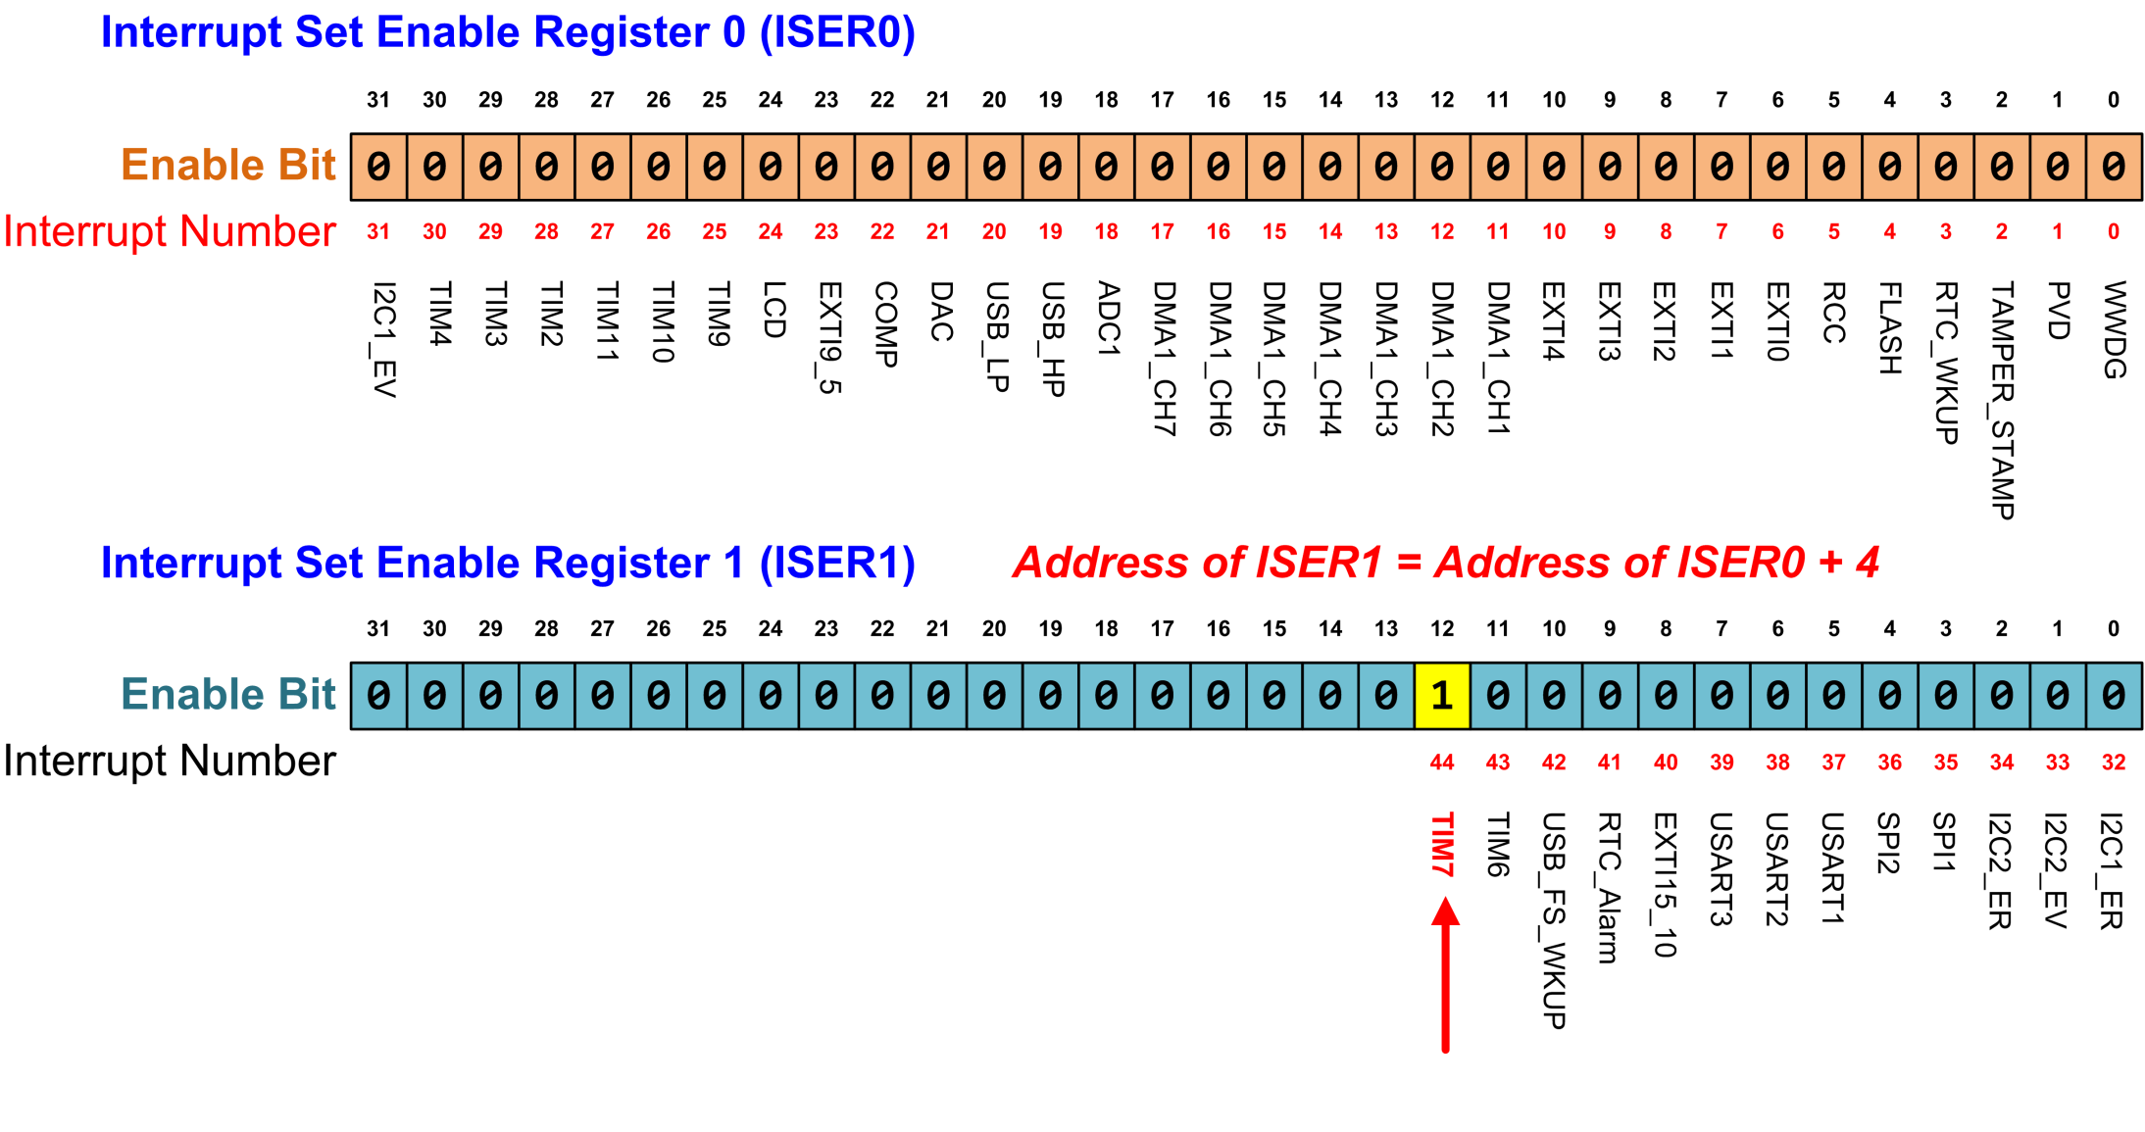
Enabling Peripheral Ints
Interrupt number of Timer 7 is 44 for STM32 processor. ISER0 enables interrupts 0 to 31. ISER1 enables interrupts 32 to 63. To enable interrupt 44, we need to set bit 12 of ISER1 to 1. (write 0 to a bit in a ISER register does not disable the corresponding interrupt)
TIM7_IRQn = 44
NVIC->ISER[1] = 1 << 12; // Enable Timer 7 interrupt
Notes:
{{Pause=2}}We can enable a peripheral interrupt by writing 1 to the corresponding bit of the ISER register. {{Pause=0.5}} ISER stands for interrupt set enable register. For example, we will show how to enable the interrupt Timer 7.
The interrupt number of Timer 7 is 44 for STM 32 L1 processor. ISER0 enables interrupts 0 to 31. ISER1 enables interrupts 32 to 63. To enable interrupt 44, we need to set bit 12 of ISER1 to 1.
Note that, write 0 to a bit in a ISER register does not disable the corresponding interrupt.

Slide 55
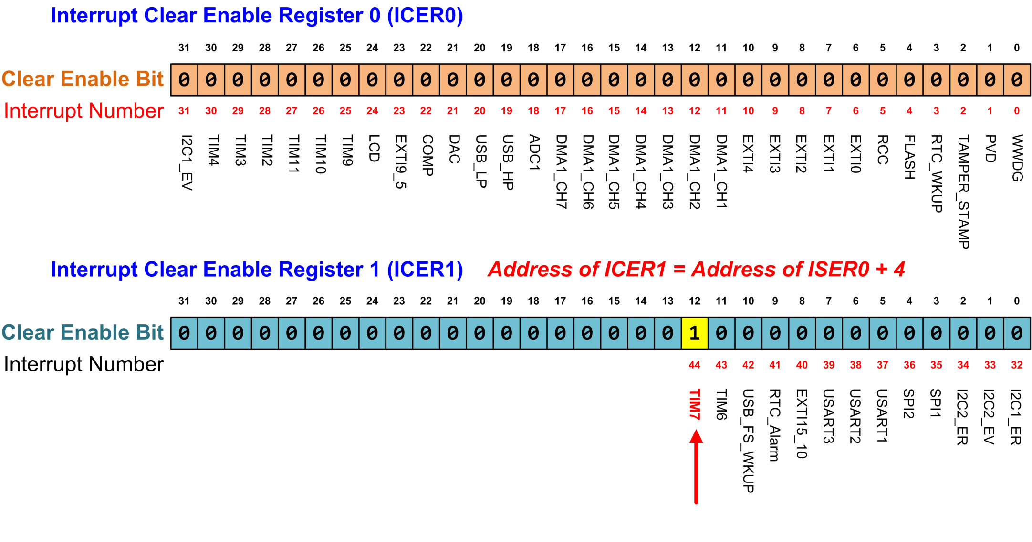
Enabling Peripheral Ints
Writing 1 to a bit in ICER disables the corresponding interrupt. To disable interrupt 44, we need to set bit 12 of ICER1 to 1. Writing 0 to ICER has no impact.
TIM7_IRQn = 44
NVIC->ICER[1] = 1 << 12; // Diable Timer 7 interrupt
Notes:
{{Pause=2}}Similarly, we can disable a peripheral interrupt by writing 1 to the corresponding bit of the ICER register. {{Pause=0.5}} ICER stands for the interrupt set disable register.
The interrupt number of Timer 7 is 44. To enable interrupt 44, we need to set bit 12 of ICER1 to 1. {{Pause=0.5}} Note that writing 1 to a bit in ICER disables the corresponding interrupt. Writing 0 to ICER has no impacts.
Separating enable bits and disable bits in two separate sets of registers, ICER and ISER, provides great convenience for software programmers. It allows us to enable or disable an interrupt flexibly, without worrying about writing zero to the other bits in the target register.

Slide 56
Disable/Enable Peripheral Interrupts
For all peripheral interrupts: IRQn ≥ 0
Method 1:
NVIC_EnableIRQ (IRQn); // Enable interrupt
NVIC_DisableIRQ (IRQn); // Disable interrupt
Method 2:
Enable:
NVIC->ISER[ IRQn / 32] = 1 << (IRQn % 32);
Better solution:
NVIC->ISER[ IRQn >> 5] = 1 << (IRQn & 0x1F);
Disable:
NVIC->ICER[ IRQn >> 5] = 1 << (IRQn & 0x1F);
Notes:
{{Pause=2}} In this slide, we will summarize how to enable or disable a peripheral interrupt. As discussed previously, the interrupt number of all peripherals is larger than or equal to zero.
There are two approaches to enable or disable a peripheral interrupt.
In the first approach, we can use the NVIC Enable and Disable functions. These two functions are provided in the ARM Cortex core header file.
In the second approach, we can directly set the corresponding bit in the ISER or ICER register.
To enable a given peripheral interrupt IRQn, we can divide it by 32 to find out in which ISER register the target enable bit is located. This is because each ISER register has 32 bits. Thus, each ISER register can enable 32 interrupts. The bit offset within the target ISER register is determined by the result of IRQn mod 32.
A better solution is to use the shift and bit-wise logic & operation, instead of the division and modulus operations. This new approach tends to run faster.
Similarly, we can directly set the corresponding bit in the target ICER register to disable interrupt IRQn.

Slide 57
Interrupt Priority
Inverse Relationship:
Lower priority value means higher urgency.
Priority of Interrupt A = 5,
Priority of Interrupt B = 2,
B has a higher priority/urgency than A.
Fixed priority for Reset, HardFault, and NMI.
Adjustable for all the other interrupts
Exception | IRQn | Priority
Reset | N/A | -3 (highest)
Non-Maskable Interrupt (NMI) | -14 | -2 (2nd highest)
Hard Fault | -13 | -1
Notes:
{{Pause=2}}What should the processor do if multiple interrupts arrive at the same time? ARM processors allow software to set priority levels for almost every interrupt. Accordingly, interrupts that needs to be responded more urgently than others, will be serviced quickly.
For ARM Cortex processors, numerically low priority values are used to specify logically high interrupt priorities. In other words, a lower priority value represents a higher urgency. This is very counterintuitive.
For example, if the priority value of interrupt A is 5, and the priority value of interrupt B is 2, then B has a higher urgency than A. Therefore, the processor will service B first if interrupt A and B arrive at the same time.
The priority of some interrupts are fixed. Specifically, the priority of three system exceptions, including reset, non-masktable interrupt (NMI), and hard fault, are fixed. Their priority levels are negative, and they have the highest urgency.
The priority level of all the other interrupts are adjustable.

Slide 58
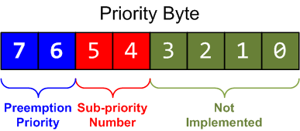
Interrupt Priority
Interrupt priority is configured by Interrupt Priority Register (IP)
With one Byte to encode priorities, it allows a maximum of 256 different priority levels, ranging from 0 to 255.
For STM32 processor, priority is stored as the most significant 4 bits of the interrupt priority byte. Each priority consists of two fields, including preempt priority number (2 bits) and sub-priority number (2 bits).
The preempt priority number defines the priority for preemption.
The sub-priority number determines the order when multiple interrupts are pending with the same preempt priority number.
default setting
Notes:
{{Pause=2}}ARM Cortex-M processors use a byte to represent the priority level. Therefore, it allows a maximum of 256 different priority levels, ranging from priority 0 to priority 255. However, the total number of available priority levels depends on the manufacturer.
For example, STM 32 L4 processors implement four priority bits, which are placed as the most significant bits of the priority byte. Therefore, the N V I C module of STM 32 L4 supports up to 16 interrupt priority levels for peripherals.
In addition, the priority bits are divided into two parts, including preempt priority and sub priority. By default, the preempt priority has the upper two bits, and the sub-priority has the lower two bits. However, the number of bits assigned to each part is configurable.
The preempt priority defines whether an interrupt can preempt an already executing interrupt. In other words, preempt priority determines if one interrupt can preempt another.
The sub priority determines which interrupt will be handled first, when two interrupts of the same preempt priority arrive at the same time. That is to say, the sub priority is used, only when two interrupts with the same preempt priority value are pending. Specifically, the interrupt with the lower sub priority value will be handled first.

Slide 59
Interrupt Priority Levels
NVIC_SetPriority(7, 6);
core_cm4.h or core_cm3.h
typedef struct {
...
// Interrupt Priority Register
volatile uint8_t IP[240];
...
} NVIC_Type;
0 | 1 | 1 | 0 | 0 | 0 | 0 | 0
IP = 0x60 = 96
It is equivalent to (shift left 4 bits, and store the result in interrupt priority byte.):
NVIC->IP[7] = (6 << 4) & 0xff;
Notes:
{{Pause=2}} Again, the priority is stored as the most significant four bits of the interrupt priority byte. For example, the statement NVIC Set Priority (7, 6) will set the priority byte of interrupt 7 to 01100000 in binary, or 96 in decimal.
In the NVIC data structure, the interrupt priority registers are mapped to a byte array. Each register holds four priority bytes. The NVIC Set Priority statement is equivalent to the following C statement. First, we shifts left, the priority value four bits, and then store the result in the corresponding interrupt priority byte.

Slide 60
Preemption and Sub-priority Configuration
NVIC_SetPriorityGrouping(n)
Perform unlock, and update AIRCR register
n | # of bits in preemption priority | # of bits in sub-priority
0 | 0 | 4
1 | 1 | 3
2 (default) | 2 | 2
3 | 3 | 1
4 | 4 | 0
Default
n = 2
Notes:
{{Pause=2}}. Within an interrupt priority byte, the number of bits in the preemption priority field and the sub-priority field can be configured by software.
For STM 32 L4 processors, there are two bits in each field. However, we can use the function NVIC Set Priority Grouping to change the size of each field. This function will change the A I R C R, register, after performing a sequence of unlocking process. A I R C R, stands for Application Interrupt and Reset Control Register.
For example, if the input n is 4, we set all 4 bits to the preemption priority. As result, the preemption priority has a total of 16 priority levels.

Slide 61
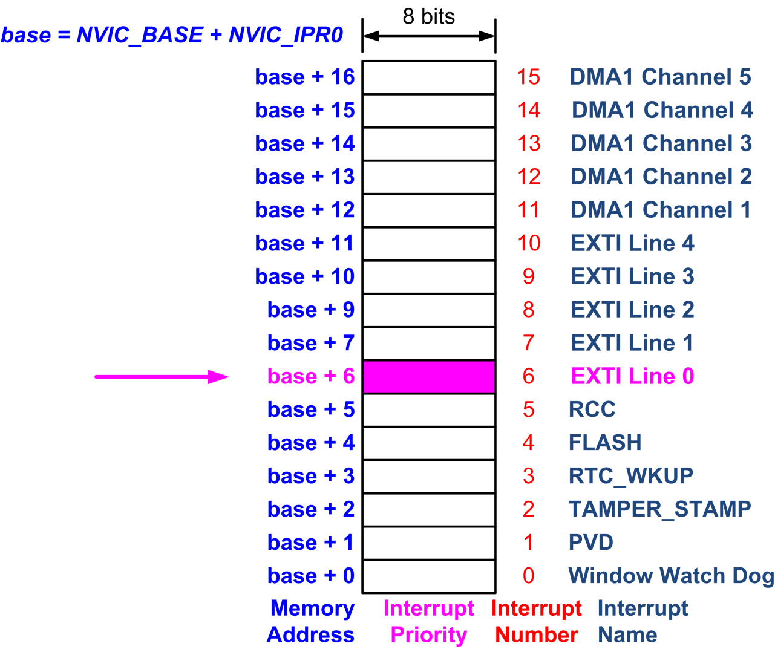
Priority of Peripheral Interrupts
// Set the priority for EXTI 0 (Interrupt number 6)
NVIC->IP[6] = 0xF0;

Slide 62
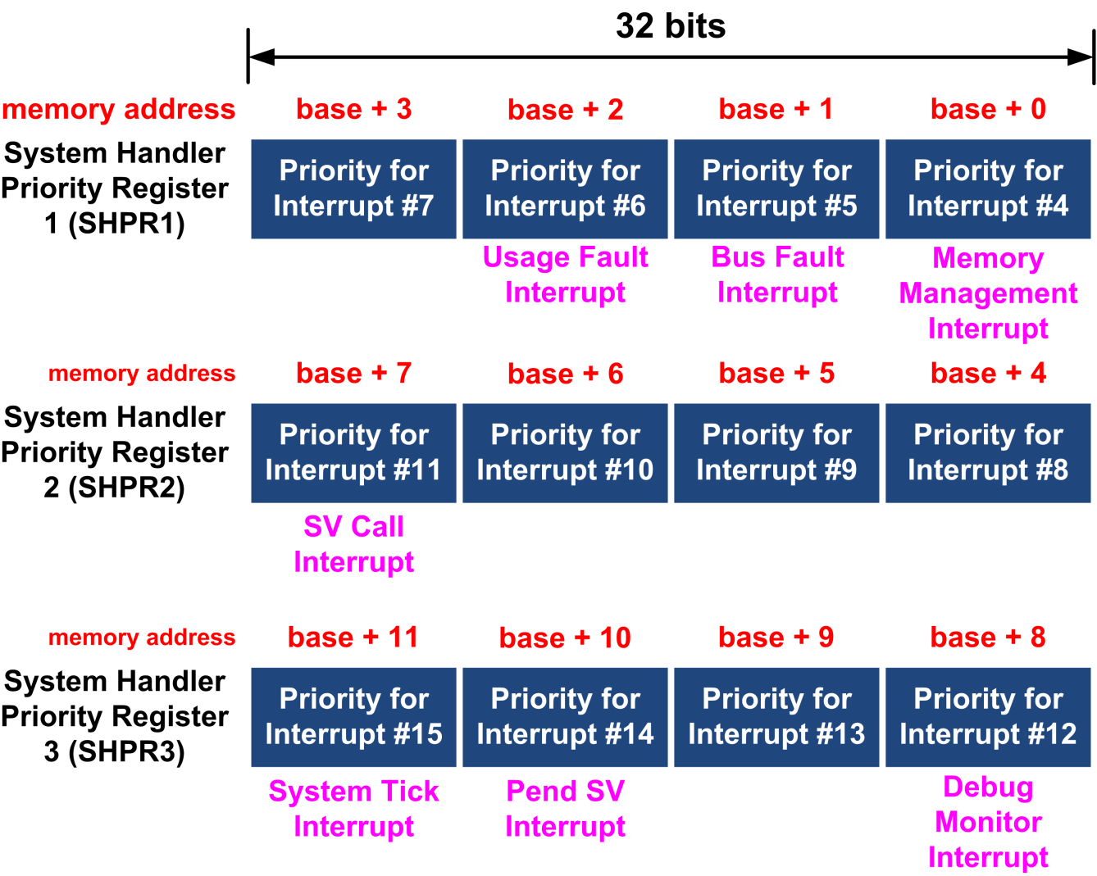
Priority of System Interrupts
// Set the priority of a system interrupt IRQn
SCB->SHP[(IRQn) & 0xF) - 4] = (priority << 4) & 0xFF;

Slide 63
Masking Priority
Disable all interrupts with less urgency
For critical code, only certain interrupts are allowed.
BASEPRI: Disable all interrupts of specific priority level or higher priority level
// Disable interrupts with priority value same or higher __set_BASEPRI( 5 << 4 )
// Critical code
...
// Remove BASEPRI masking __set_BASEPRI(0);
Notes:
{{Pause=2}}In embedded systems, we often have to perform some critical operations, in which data should not be corrupted by other interrupts. Therefore, we need to disable all interrupts with less urgency to ensure that the execution of the critical code will not be interrupts by other interrupts.
We can use the Base Priority Mask Register(BASEPRI) to achieve the protection of critical code. In this example, we disable all interrupts with a priority value of 5 or higher. After executing the critical code, we can remove the interrupt masking by resetting the BASEPRI register to zero.

Slide 64
Exception-masking registers (PRIMASK, FAULTMASK and BASEPRI)
PRIMASK: Used to disable all exceptions except Non-maskable interrupt (NMI) and hard fault.
Write 1 to PRIMASK to disable all interrupts except NMI
Write 0 to PRIMASK to enable all interrupts
FAULTMASK: Like PRIMASK but change the current priority level to -1, so that even hard fault handler is blocked
BASEPRI: Disable interrupts only with priority lower than a certain level
Example, disable all exceptions with priority level higher than 0x60
MOV R0, #1
MSR PRIMASK, R0
MOV R0, #0
MSR PRIMASK, R0
MOV R0, #0x60
MSR BASEPRI, R0

